Slide 1
NWEN 304 Group Project
Dilitha Wijayapala, Ronnie Grant, Jeff Peake

Slide 2
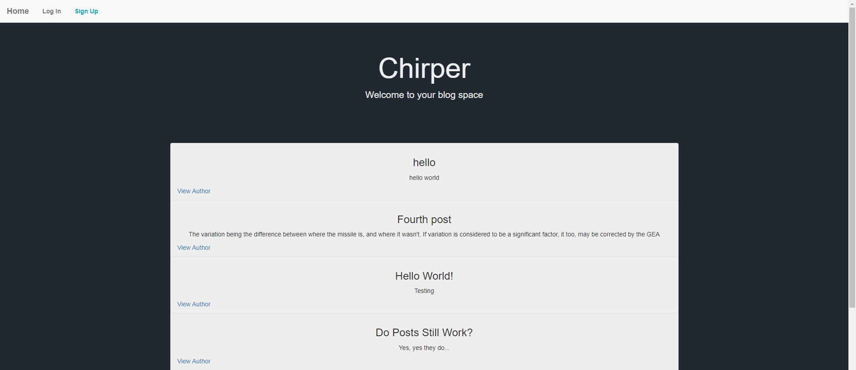
Introduction
Social media website
Authenticated users can create, edit and delete their own posts.
Unauthenticated users can view posts in total list or by each user

Slide 3
Main Components
Model
Firebase Firestore (NoSQL)
Controller
Controller files (eg. auth.js, database.js )
Route files (eg. UserRoutes.js, ProtectedRoutes.js)
Public client-side scripts (e.g., add-post.js, login.js)
View
EJS files (eg. index.ejs, navbar.ejs)
Render engine (receives data from route methods)
Bootstrap

Slide 4
Features
Email login and sign up (including password control)
Google login
JWT cookie implementation
Firebase Firestore DB (NoSQL)
Dynamic endpoints
Entire server is hosted
Exposed two CRUD functionalities for web service (read and write)
Performance analysis
Email loop for password reset
User timeout functionality

Slide 5
Initial Workload Distribution
Jeff
Web service
Read functionality
Basic implementation of web app
Password Reset email
Dili
Write, update and delete functionality
Basic implementation of web app
Authentication
Timeout functionality
Ron
Styling for web app
Authorization Testing
Performance testing
Deployment and Hosting

Slide 6
Contributions
Jeff
Web service
Read functionality
Basic implementation of web app (EJS file implementation)
Password Reset email
Dili
Write, update, and delete functionality
Basic implementation of web app (Routing in server)
Authentication (JWT, OAUTH for Google)
Timeout functionality
Ron
Styling for web app
Authorization Testing
Performance testing
Deployment and Hosting on Google Cloud

Slide 7
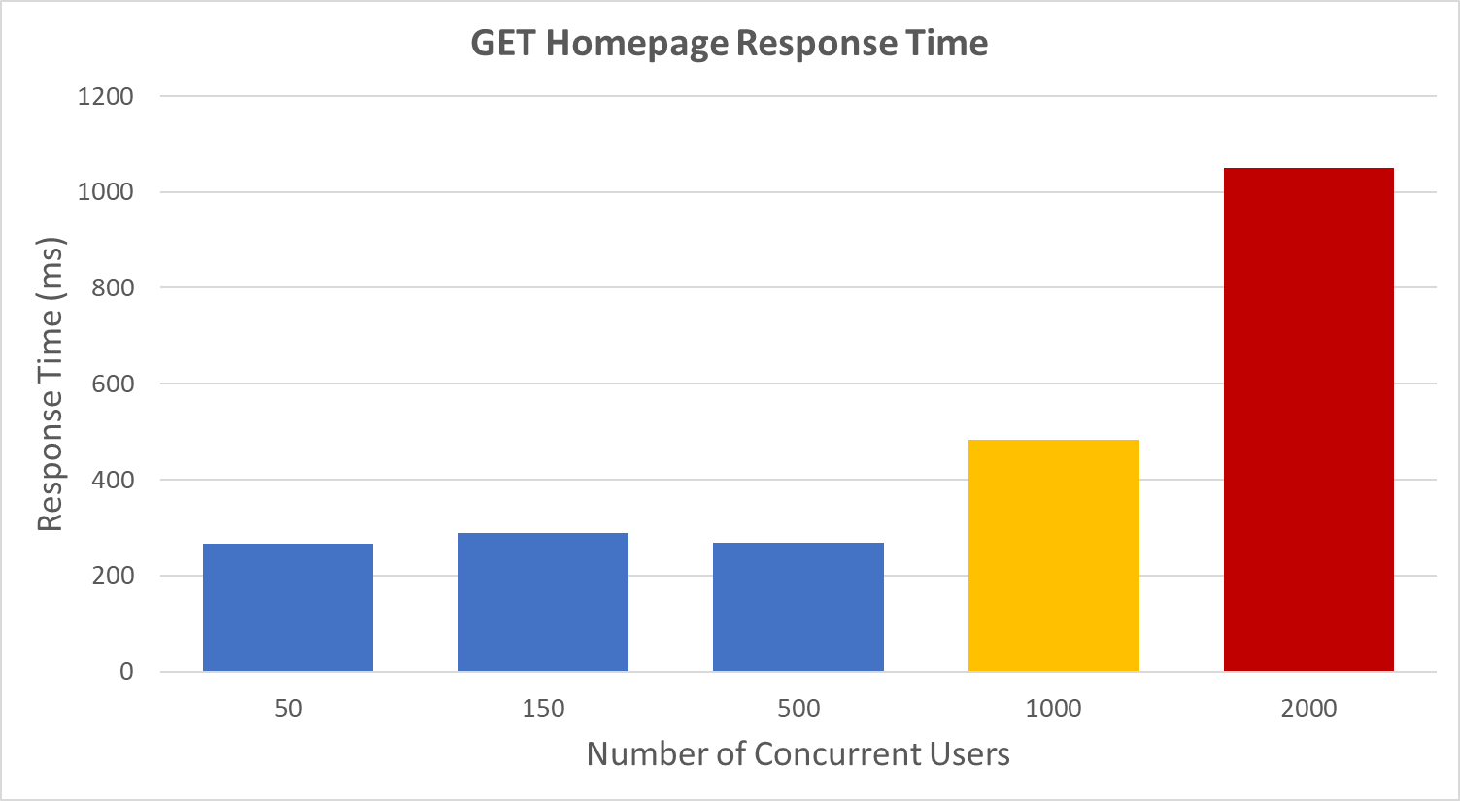
Performance Analysis - GET Homepage
Consistent Response Times for 50-500 users. Longer response times for >1000 users. Latency likely caused by needing to query database for posts when loading the homepage

Slide 8
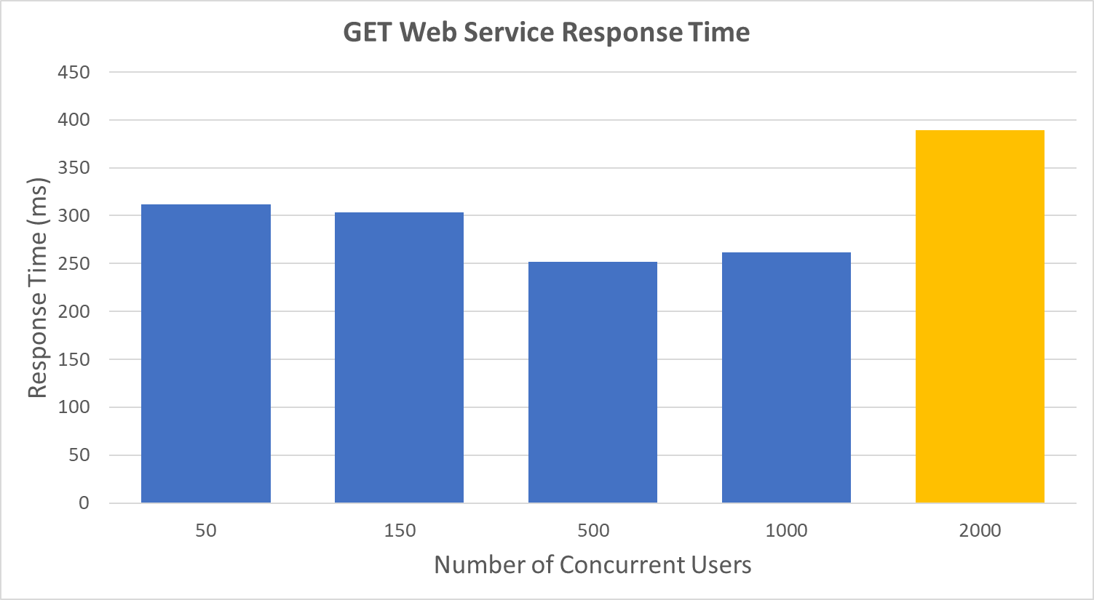
Performance Analysis - Web Service API
Web service is performant with relatively consistent response times for a range of loads. 2000 concurrent users only slightly increases response latencies.

Slide 9
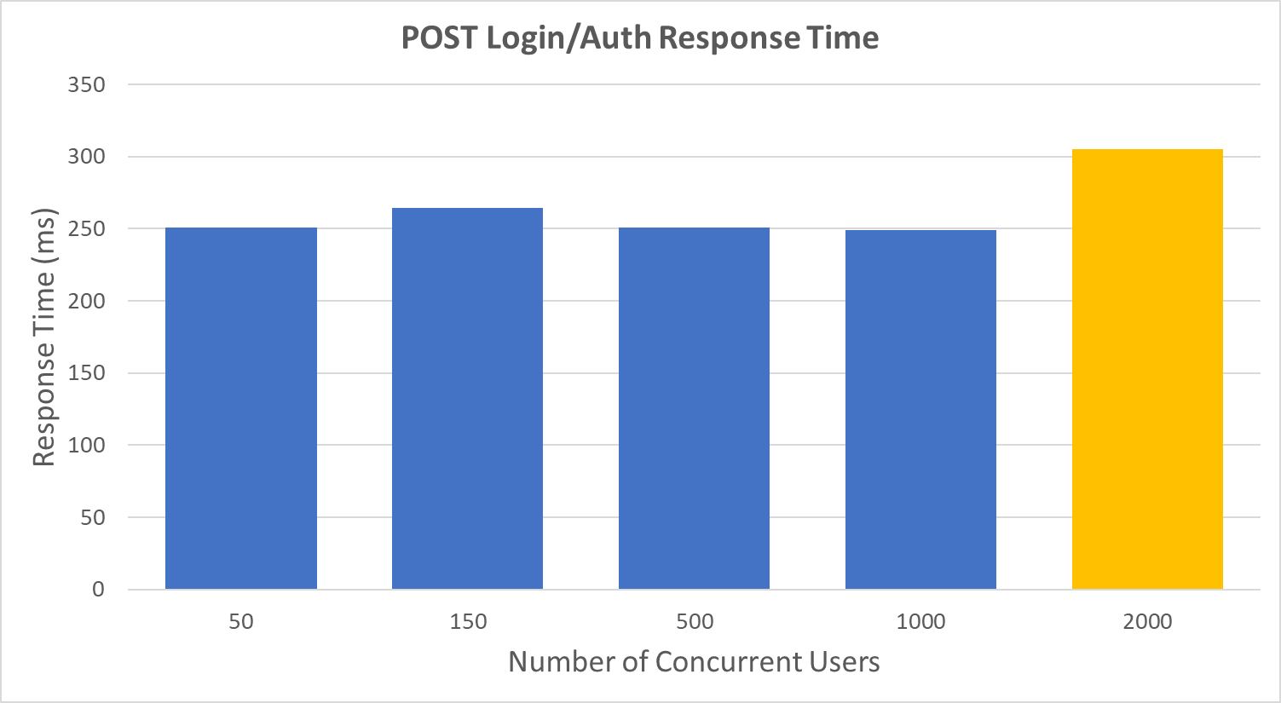
Performance Analysis - Authentication API
Similar response time performance for Login/Auth API. Latency increase only seen with 2000 concurrent users accessing.

Slide 10
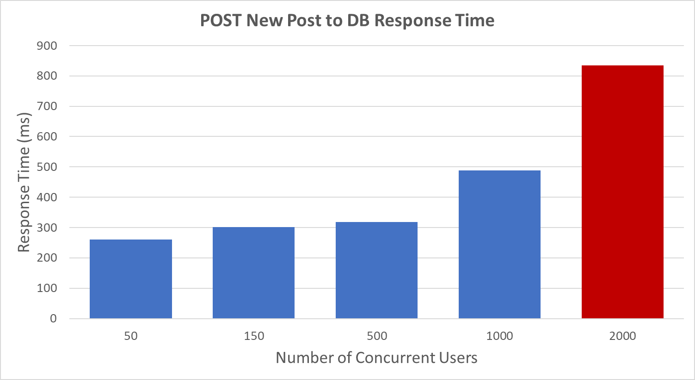
Performance Analysis - Writing to the Database
Consistent increase for response time latency as concurrent users increase. When concurrent users reached 2000, HTTP requests began to fail, with a failure rate of 5%.

Slide 11
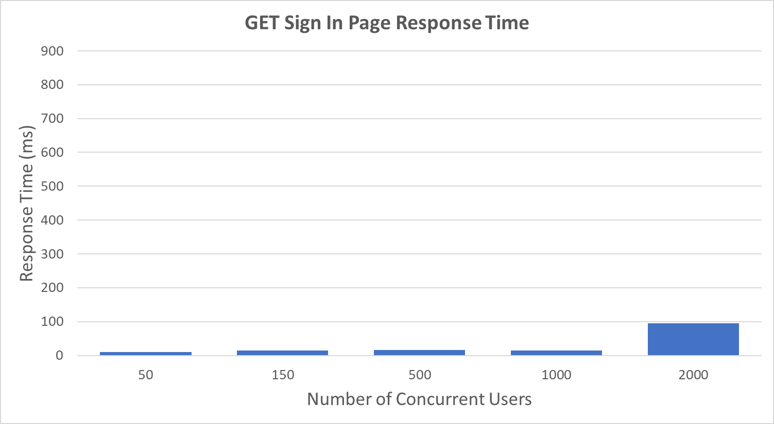
Performance Analysis - Is the DB a Bottleneck?
We tested on Localhost to isolate the what was causing a bottleneck , when requesting a page that does not need to make a query to the DB, in this example the Sign In page, request latencies do not show significant increase in response time latency as concurrent users increase.
Writing to the DB (Right) shows significant latency under load with some failed HTTP requests. This indicates that the DB is a bottleneck when under load. Another example of a bottleneck can be shown in when requesting the homepage.

Slide 12
Demo
https://chriper-webapp-atel43p7da-uc.a.run.app/

